Slide 1
AIRPORT FLIGHT BOARD AND SCHEDULER
JAVA PROGRAMMING · MINI PROJECT
A Java application built from the concepts of Modules 1 to 6
TEAM 19
Sowmya – 2620030693 · Navaneeth – 2620030694
FLIGHT
DESTINATION
DEPARTS
STATUS
Notes:
Title slide. The strip at the bottom imitates the header row of an airport departure board, which is the screen this project builds.

Slide 2
ABSTRACT
THE PROJECT IN BRIEF
The Airport Flight Board and Scheduler is a Java application that stores, organizes and displays flight information the way an airport departure board does. Each flight has a flight number, destination, departure time, gate and status. The program lets an operator add, update, cancel and search flights, keeps the board sorted by departure time, and saves the schedule to a file so it is still there the next time the program runs. The project applies the concepts of Modules 1 to 6 in the order they are taught.
KEY CONCEPTS
Algorithms and flowcharts
Classes and objects
Exception handling
Strings and file I/O
Collections and streams
Airport Flight Board and Scheduler
2
Notes:
The abstract is the one-paragraph summary: what the program does, what data it handles and which course concepts it uses.

Slide 3
UNDERSTANDING THE PROBLEM STATEMENT
PROBLEM STATEMENT
Airports need one clear, current view of every flight. Entering flights by hand on paper or in scattered files invites duplicates, wrong times and out-of-date status. The task is to build a program that records flights, keeps them in departure order, lets staff search and update them, and saves the schedule.
INPUT
PROCESS
OUTPUT
Flight number
Destination
Departure time
Gate
Status
Validate each entry
Store the flights
Sort by departure time
Search and update status
Sorted departure board
Delayed and cancelled report
Schedule saved to a file
Airport Flight Board and Scheduler
3
Notes:
Frame the problem as input, process and output. Every module that follows supplies one part of the process.

Slide 4
ALGORITHMS AND FLOWCHARTS
MODULE 1
CONCEPTS
IN THE PROJECT: ADD A FLIGHT
An algorithm is a list of ordered steps from Start to Stop
Flowchart symbols: oval for start and stop, parallelogram for input and output, rectangle for a process, diamond for a decision
A loop repeats steps while a condition such as i <= n is true
Start
Read the flight details
Check whether the flight number already exists
If it exists, show an error; otherwise store the flight
Display the updated board
Stop
Airport Flight Board and Scheduler
4
Notes:
Module 1 is where the solution is planned on paper. The add-a-flight algorithm is the first design for the program.

Slide 5
JAVA BASICS: DATA, INPUT, OPERATORS
MODULE 2
CONCEPTS
IN THE PROJECT: LABEL A FLIGHT
Data types: int, long, double and String
Scanner reads input from the user
Operators: arithmetic, relational, logical, ternary, assignment, ++ and --
Scanner s = new Scanner(System.in);
System.out.println("enter flight no");
String no = s.next();
int delay = s.nextInt();
String st = delay > 0 ? "DELAYED" : "ON TIME";
Read a flight number and a delay, then set the status with the ternary operator.
Airport Flight Board and Scheduler
5
Notes:
Module 2 turns the algorithm into Java statements: variables to hold flight data, Scanner to read it, and operators to decide the status.

Slide 6
CONTROL FLOW, LOOPS AND ARRAYS
MODULE 3
CONCEPTS
IN THE PROJECT: PRINT THE BOARD
if, else-if and nested conditions choose between outcomes
for loops repeat a task; nested loops build rows and columns
An array holds same-type elements, indexed from 0, filled and printed with loops
String[] dest = {"Delhi", "Mumbai", "Chennai"};
for (int i = 0; i < dest.length; i++) {
System.out.println(dest[i]);
}
A loop walks through the array and prints one row for every flight. An if statement can mark a row as delayed.
Airport Flight Board and Scheduler
6
Notes:
Module 3 gives the program its first working board: arrays store the flights and loops display them.

Slide 7
OBJECT-ORIENTED DESIGN
MODULE 4
The Flight class is the blueprint; every flight on the board is an object created with new.
ENCAPSULATION
ABSTRACTION
Flight keeps its fields private and exposes them only through methods.
Staff use addFlight() and searchFlight() without seeing how flights are stored.
INHERITANCE
POLYMORPHISM
DomesticFlight and InternationalFlight extend Flight and reuse its code.
Each flight type overrides displayDetails(), so one call prints the right format.
Airport Flight Board and Scheduler
7
Notes:
The four pillars of OOP, each tied to one design decision in the flight board. DomesticFlight and InternationalFlight are the project's own example classes.

Slide 8
STATIC MEMBERS AND EXCEPTIONS
MODULE 4 (CONTINUED)
STATIC MEMBERS
EXCEPTION HANDLING
THIS, SUPER, INTERFACES
One shared copy per class, not one per object
totalFlights counts every flight created
AIRPORT_NAME is a static constant
try runs risky code, catch handles the error, finally always runs
A bad departure time is caught and the user is asked again
A missing flight shows a message instead of crashing
this is the current object; super is the parent class
Constructor chaining sets inherited fields first
Coding to an interface lets new flight types plug in
Airport Flight Board and Scheduler
8
Notes:
Exception handling is the centre card because it keeps the board running when input is wrong or a flight is not found.

Slide 9
STRINGS, SORTING AND FILE I/O
MODULE 5
STRINGS
LIBRARY ALGORITHMS
FILE I/O
Strings are immutable; StringBuilder changes text in place
split(",") breaks a saved line such as AI101,Delhi,18:45 into fields
equals() compares flight numbers
Collections.sort() orders the board
Comparable gives the natural order, departure time
Comparator adds other rules, such as destination
Files.writeString() saves the schedule
BufferedReader reads it back line by line
try-with-resources closes the file automatically
Airport Flight Board and Scheduler
9
Notes:
Module 5 handles text, order and storage: formatting each board row, sorting flights by time, and keeping the schedule in a file between runs.

Slide 10
COLLECTIONS AND GENERICS
MODULE 6
ArrayList<Flight>
HashMap<String, Flight>
Ordered list of all flights, with fast access by index.
Finds a flight by its number; every key is unique.
HashSet<String>
TreeMap<String, Flight>
Stores each destination once; duplicates are ignored.
Keeps flights sorted by key, such as departure time.
Generics such as ArrayList<Flight> accept only Flight objects, so type errors are caught early.
Airport Flight Board and Scheduler
10
Notes:
Arrays from Module 3 are replaced by collections that grow, look up and sort flights. Pick the collection by the question you need to answer.

Slide 11
LAMBDAS AND STREAMS
MODULE 6 (CONTINUED)
CONCEPTS
IN THE PROJECT: DELAYED REPORT
Functional interfaces: Predicate, Function, Consumer, Supplier, Comparator
A lambda such as f -> f.isDelayed() passes behaviour as a value
A pipeline has a source, intermediate steps (filter, map, sorted) and one terminal step (forEach, collect, count)
flights.stream()
.filter(f -> f.isDelayed())
.sorted()
.forEach(System.out::println);
Collectors.groupingBy with counting() reports how many flights have each status.
Airport Flight Board and Scheduler
11
Notes:
Streams replace manual loops for reports: filter the delayed flights, sort them and print them in one pipeline.

Slide 12
CONCLUSION
WRAPPING UP
The Airport Flight Board and Scheduler brings the course together in one working program. Each module adds a layer, from the first algorithm to stream-based reports, and the result is a flight board that is organized, searchable and saved between runs.
1 Algorithms and flowcharts
2 Data, input and operators
3 Control flow and arrays
4 OOP and exceptions
5 Strings, sorting and files
6 Collections and streams
Possible extensions: a graphical display, a database, and live status updates.
Airport Flight Board and Scheduler
12
Notes:
Recap the six modules in order, then close with possible extensions. Thank the audience and take questions.

Slide 13
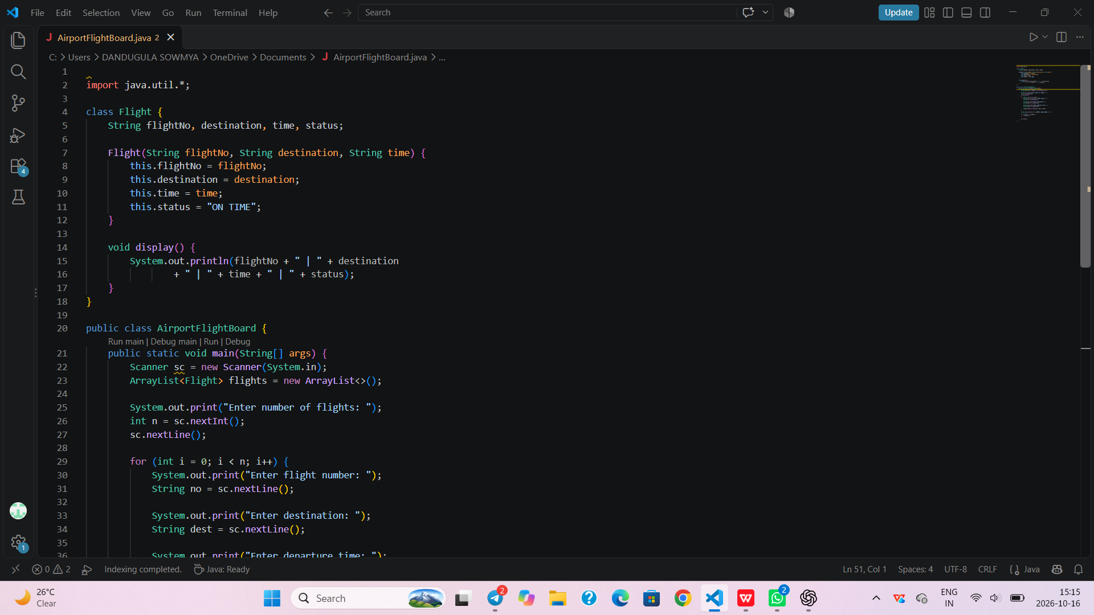
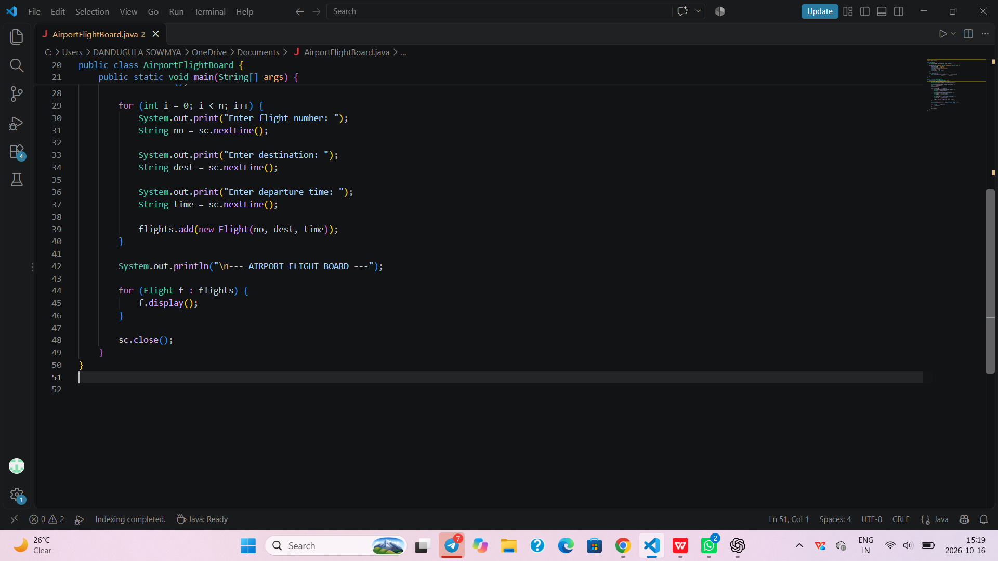
Screenshot

